Slide 1

Enhancing Scientific Inquiry with R for Data Manipulation and Visualization
Leveraging R for Advanced Data Visualization and Analysis
by Alex Paquette

Slide 2
Overview
Data preprocessing and cleaning
Data visualization using bar charts and scatter plots
Benefits and shortcomings
Future suggestions for improvement

Slide 3
Data preprocessing and cleaning
Data must be prepared before it can be visualized
1
Missing values must be handled
2
Data structure must be modified
3
New data must be derived
4

Slide 4
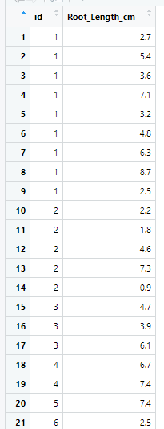
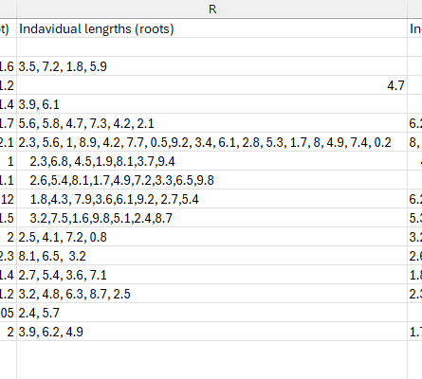

Slide 5
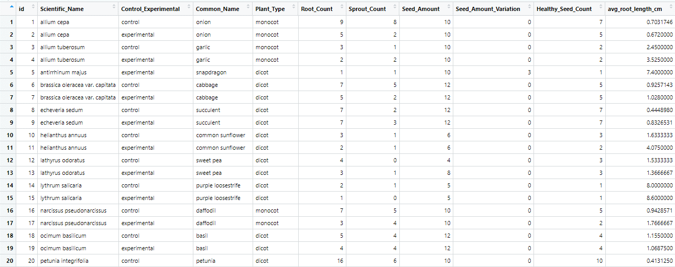
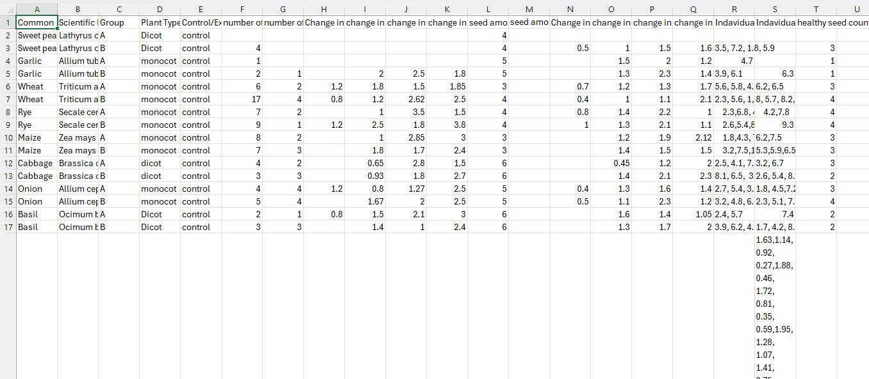
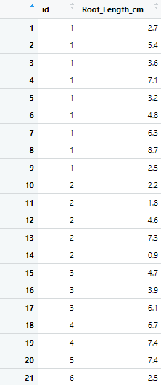
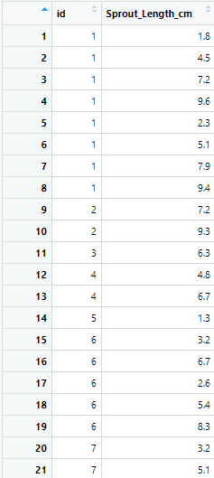

Slide 6
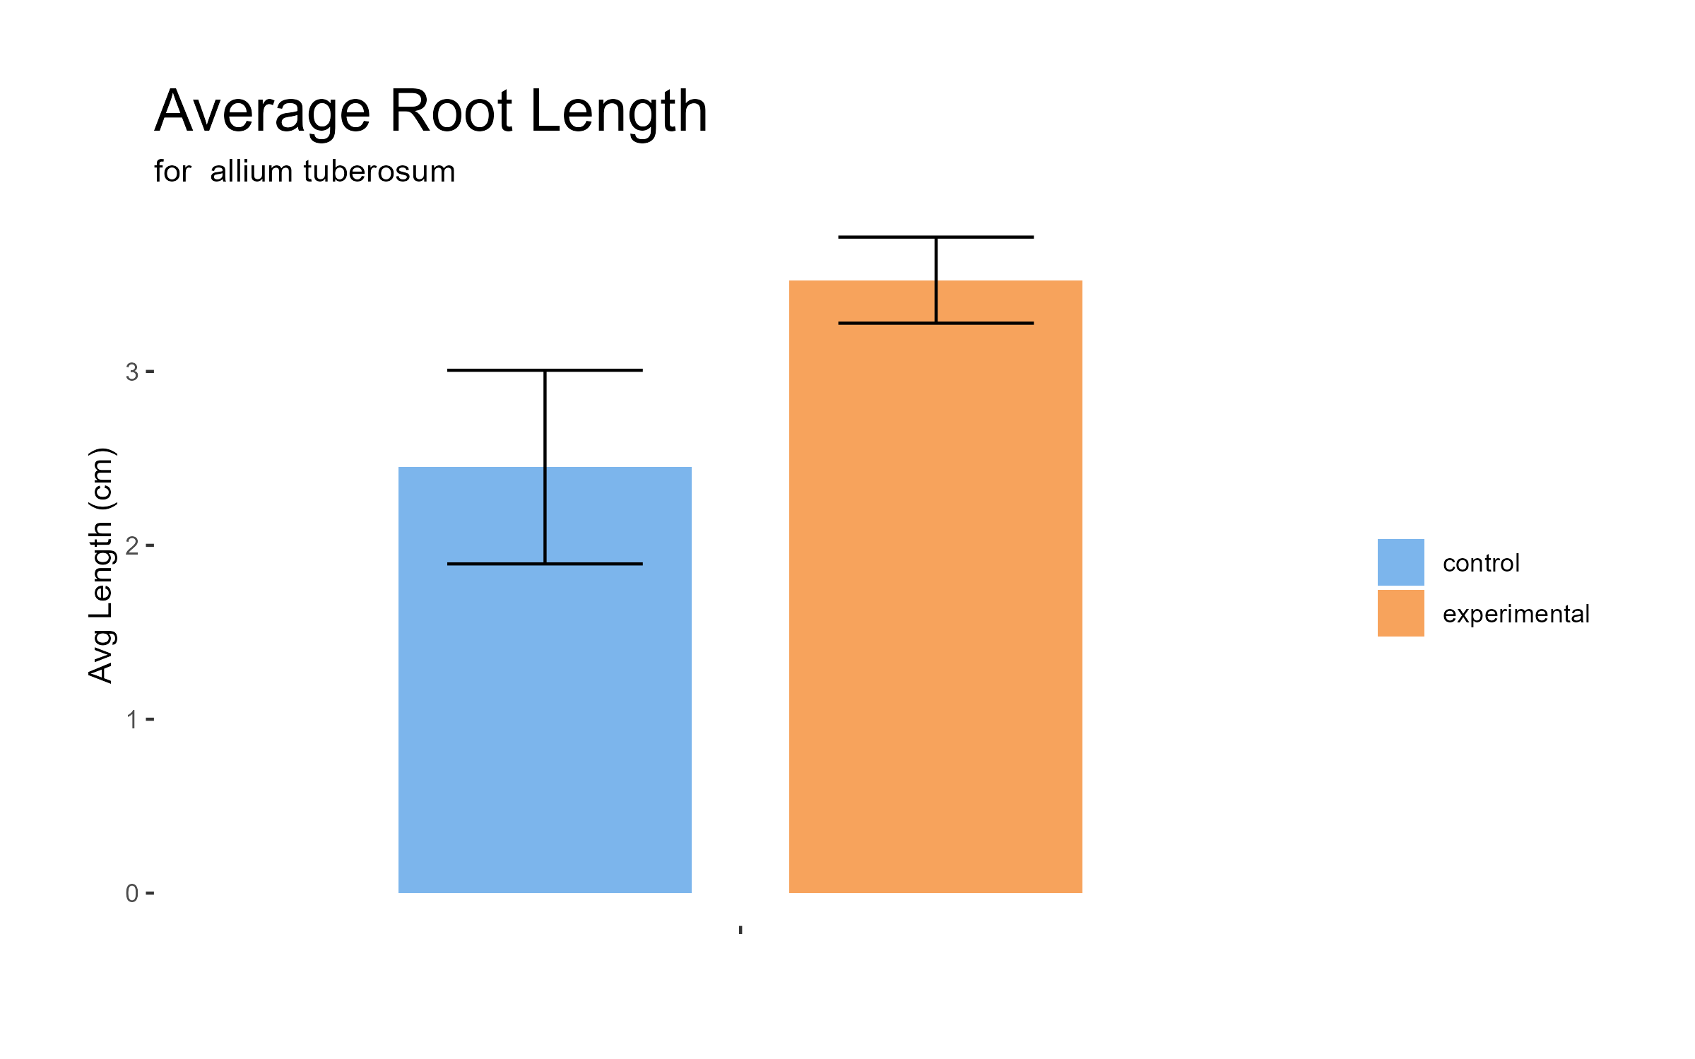
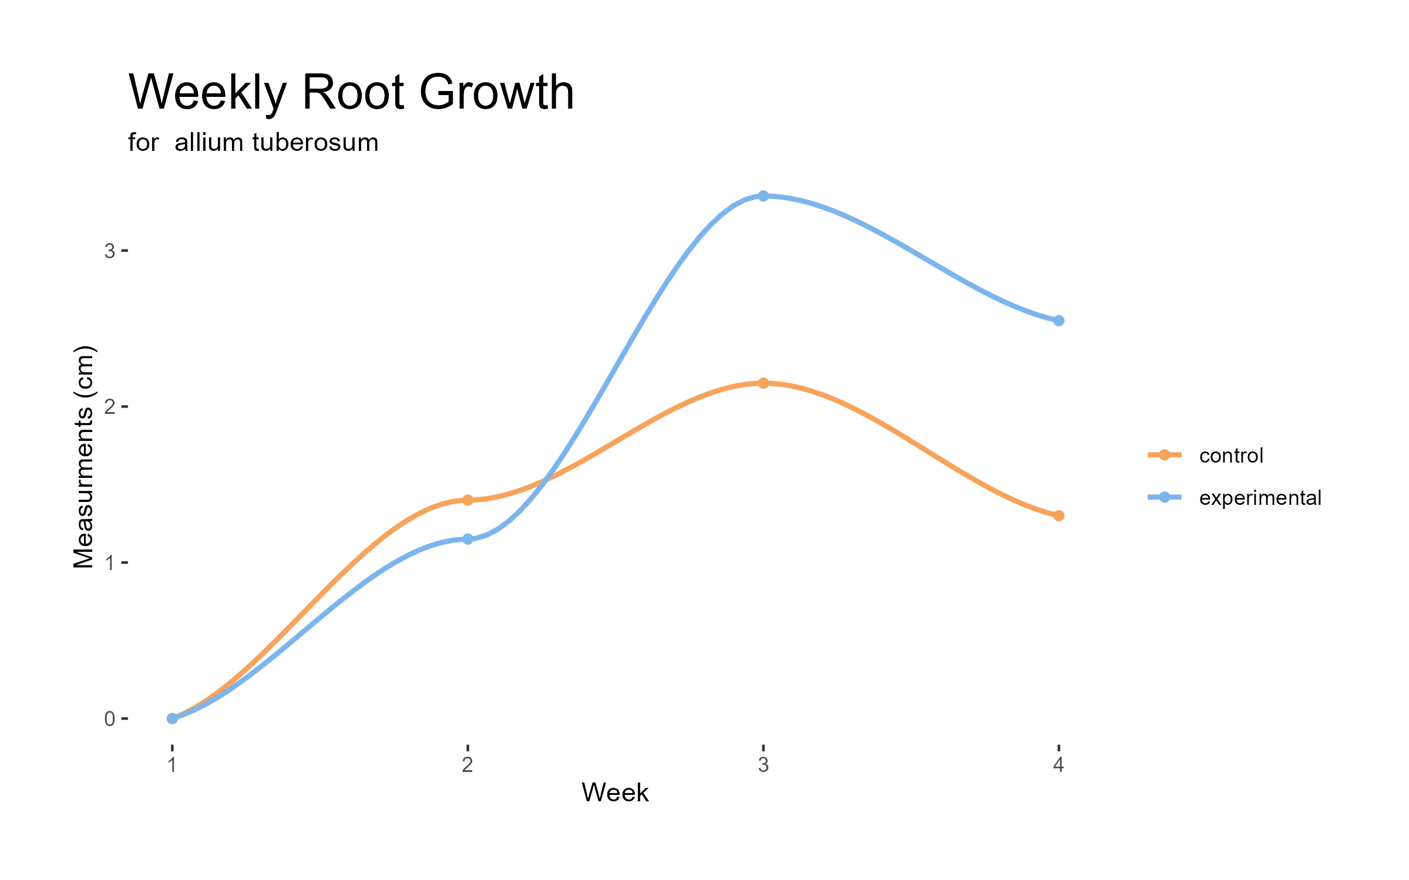
Data Visualization Techniques
Bar charts
Scatter Plots

Slide 7
Benefits and Shortcomings
Create clean, reproducible, consistent, and high-quality visualizations
Expedite the analysis process
Mass production of visualizations
Initial data not well formatted for digital data processing
Large time investment in data preprocessing
Missed visualization opportunities during data collection

Slide 8
Future Suggestions
Close collaboration with data producers
Implementing data validation protocols during data collection
Enhance researchers’ proficiency in R programming and statistical analysis
Explore the use of machine learning for automated data cleaning

Slide 9

Questions?

